Slide 1
Name: Md. Sohan Millat Sakib ID:222902036
Simple Encryption

Slide 2
CONTENTS:
Introduction .
Objectives .
Tools & Languages used in the Project .
Features used in this project.
Implementations Limitations & Future Updates .
Conclusion.

Slide 3
Introduction
Encryption is the method by which information is converted into secret code that hides the information's true meaning.
Decryption converts an encrypted or encoded message into a readable form and can be understood by the user or system.

Slide 4
Objectives
Encrypt or Decrypt any message for security purpose.
Hide data from hackers and unwanted people.

Slide 5
Application
The main application of this program is secret communication.

Slide 6
Tools & Languages used in the Project
Using Code Blocks for writing code.
Using C(C11) language for developing the program.
I use GCC Compiler for compiling the Code.
This Program runs on terminal.

Slide 7
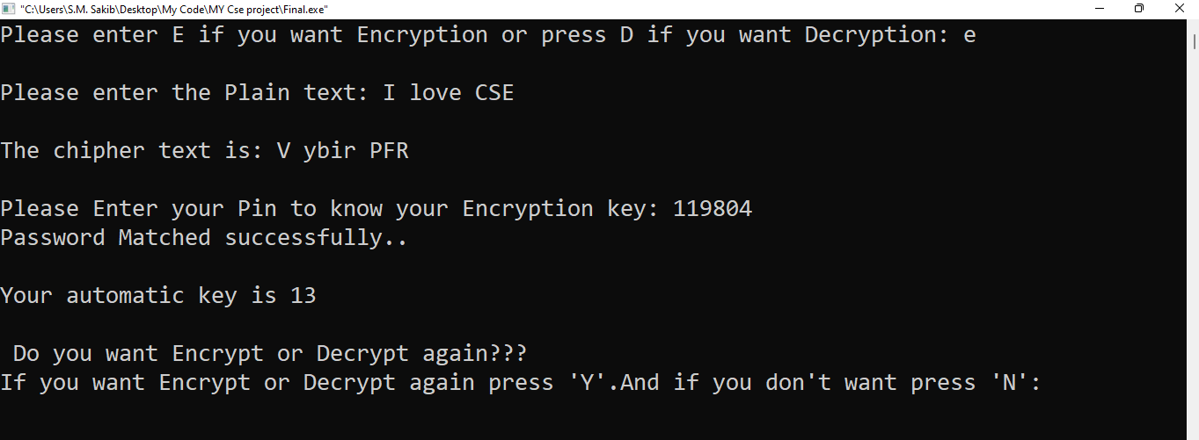
Implementation
Caesar cipher: Caesar cipher is a simple Encryption method that encrypts plain text into cipher text by a key. And if we want to decrypt message we have to know about the key.
Here the program Encrypted message by using key using 13 which is automatic generated.

Slide 8
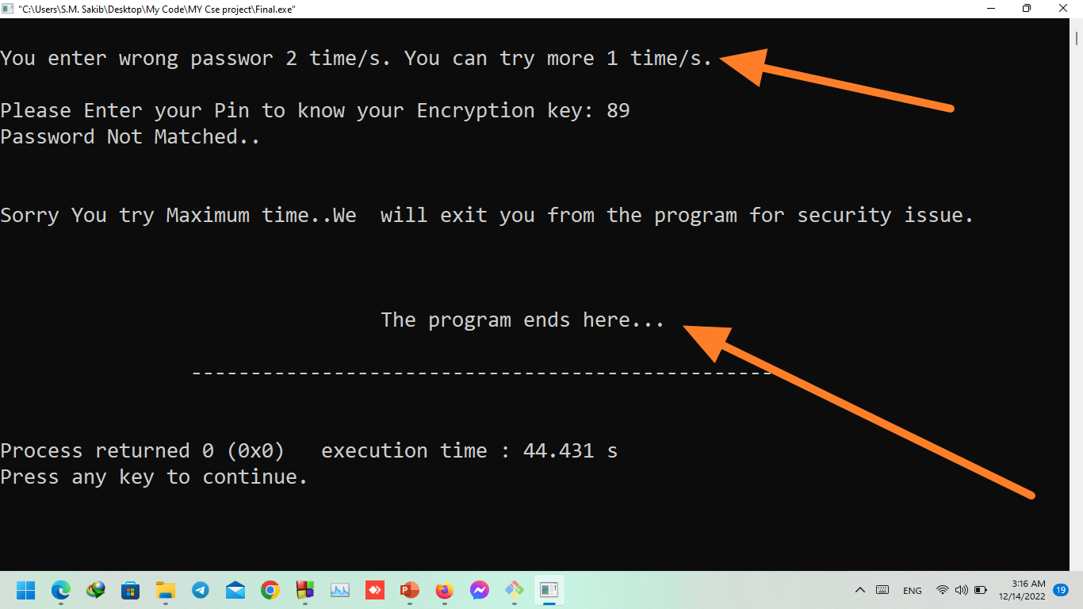
If I enter the wrong pin to get the key it will not give me the key to decrypt the message and if put wrong password 3 times program will be closed.

Slide 9
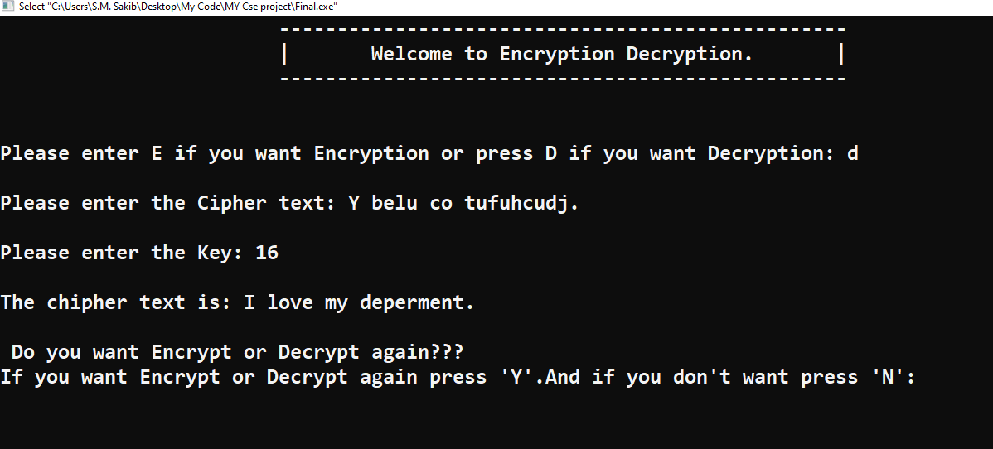
If I know key and I have encrypted message I can easily decrypt the message.

Slide 10
Features used in this project
.
Auto Encrypt message by a key.
To know the key, you need to know the password.
If you Enter the wrong password 3 times the program will be closed.
You can also decrypt a message using the proper key.

Slide 11
Implementations Limitations & Future Updates
Limitation:
The limitation of the project is it encrypts any message by the key 1-26. So there has the risk to Brute Force attack.
Updates:
(I) In the future I will develop this project using GUI-based Language for getting a better user experience.
(II) I will be using a word type key instead of digits to encrypt the message.

Slide 12
Conclusion
The Encryption and decryption methods used worldwide by tech giant communication company which are very important for securing our messages. We can use encryption methods not only to encrypt our message but also to encrypt any kind of data.
We should keep our data secure our information.

Slide 13
Thank you.

